Slide 1

A MAJOR PROJECT
On
COLLEGE MANAGEMENT SYSTEM
(Streamlining College Administration with Efficient Technology)
BACHELOR OF TECHNOLOGY
IN
CSE- AI & ML
BY
ANUSHA PULLELA 20VE1A66A6
S. SNEHA REDDY 20VE1A66B0
SINGARAPU RUTHVIK 20VE1A66A9
ANIRUDH KOWLURI 20VE1A6688
Under the Guidance of
Dr. A SWATHI- HEAD OF THE DEPARTMENT
ACADEMIC YEAR: (2020-2024)

Slide 2

ABSTRACT
PROBLEM STATEMENT
EXISTING SYSTEM
PROPOSED SYSTEM
LITERATURE SURVEY
SOFTWARE REQUIREMENTS
HARDWARE REQUIREMENTS
SYSTEM ARCHITECTURE
MODULES
DATABASE
UML DIAGRAMS
MODULES DESCRIPTION
RESULTS
CONCLUSION
REFERENCES
QUERIES
TABLE OF CONTENTS

Slide 3

The College Information Management System (CIMS) is a project designed to streamline the maintenance of college information through a user-friendly web-based platform. It aims to solve issues such as scattered data and slow access present in manual systems.
The main problems addressed by CIMS include inefficiencies in existing manual college information systems, such as scattered data and slow access. These problems make it difficult to manage the increasing volume of college information efficiently.
The proposed CIMS provides a centralized solution for managing college records, attendance, and academic resources, thus improving efficiency and accessibility compared to existing manual systems.
ABSTRACT

Slide 4
PROBLEM STATEMENT
The manual college information systems that are already in place are inefficient due to slow pace access times and dispersed data. While some rely on systems with very little computerization, others employ paper-based methods. To address these inefficiencies, a web-based platform for streamlined record-keeping is provided by the proposed CIMS. It guarantees the accurate handling, convenient access, and efficient data integrity of college information. By offering a central database, the CIMS removes the redundancy and inconsistent nature of manual methods. Data duplication and conflicting records are reduced when all college information is kept in one location, guaranteeing data correctness and integrity. In contrast to systems that are paper-based or just partially automated, the CIMS provides real-time access to college information. Instantaneous access and updating of information by users minimizes waiting times for data retrieval and guarantees constant availability of information to stakeholders.

Slide 5
EXISITING SYSTEM
Existing manual college information systems are characterized by a variety of methods, ranging from paper-based systems to minimally computerized processes. These systems face significant inefficiencies, including scattered data, slow access, and limited accessibility.
With data stored in physical formats, retrieving and updating information becomes time-consuming and error-prone. Moreover, manual systems hinder effective data analysis, posing challenges in identifying trends and patterns crucial for academic and administrative decision-making.
Security risks also loom large, as paper records are vulnerable to loss, damage, and unauthorized access. Delays in obtaining information further impede college operations, necessitating additional effort from staff and stakeholders.
As such, there is a pressing need for modern solutions like the proposed College Information Management System (CIMS) to streamline processes, enhance accessibility, and improve overall efficiency in college information management.
The project aims to address these shortcomings by leveraging the strengths of automated systems in developing a more efficient College information management system.

Slide 6
DEMERITS
Inefficiency: Paper-based systems introduce inefficiencies through manual data processes, slowing down tasks like data entry, retrieval, and updates, leading to delays in processing vital College information.
Error Vulnerability: Manual data entry increases the risk of errors, potentially impacting Colleges' academic standing or eligibility for scholarships due to inaccuracies in records, such as grades.
Limited Accessibility: Physical storage of paper records hampers quick access, inconveniencing Colleges and staff, particularly those not physically present at the institution.
Data Analysis Challenges: Paper-based systems hinder effective analysis of College data, limiting institutions in identifying trends, patterns, and areas for improvement in academic and administrative processes.
Security Risks: Paper records are susceptible to loss, damage, and unauthorized access, posing significant risks to the privacy and security of sensitive College information.

Slide 7
The College Management System is a comprehensive software solution designed to streamline administrative tasks within educational institutions.
The College Information Management System (CIMS) includes modules such as User Authentication, College Management, Counselor, Administrator, Search and Retrieval, and Reports Generation and Communication.
It facilitates efficient management of college records, attendance, and academic resources through a user-friendly interface.
As part of its resource management capabilities, the CIMS integrates past question papers for exam preparation. Faculty members can upload question papers to the system, categorizing them by course or subject for easy access by students.
The system facilitates enhanced interaction between faculty members and college administration through streamlined administrative tasks. Faculty members can communicate directly with administrators, submit requests, and access administrative support services through the system.
PROPOSED SYSTEM

Slide 8
MERITS
Efficiency: The system enhances efficiency by automating processes, reducing manual workload, and facilitating quick access to College information.
Centralized Information: It provides a centralized database, eliminating scattered data and ensuring a unified source for College records.
Accuracy: Automation reduces the risk of errors, ensuring accurate and reliable College information, which is crucial for academic and administrative decision-making.
User-Friendly Interface: The user-friendly interface makes it easy for administrators and staff to navigate and utilize the system effectively.
Time Optimization: Automated processes save time in data entry, retrieval, and updates, allowing educational institutions to allocate resources more efficiently.
Data Analysis: The system enables effective data analysis, helping institutions identify trends, patterns, and areas for improvement in both academic and administrative processes.

Slide 9
LITERATURE SURVEY
1. Paper Title: College Management System (2023)
Authors: Rohit Jain, Aman Modi, Ishan Kashyap, Prof. Vandana Kate, Prof. Rachana Bahrawat
Description: Aims to develop an Online Intranet College Management System (CMS) for educational institutions or colleges.
Drawbacks: The system's lack of customization options hampers users' ability to tailor it to their needs, hindering satisfaction and productivity. Additionally, the limited flexibility of the user interface poses usability challenges and frustrates users. Compatibility issues with diverse devices and software environments further impede usability and present technical hurdles for administrators.
2. Paper Title: Student Information Management System (SIMS) (2022)
Authors: C K Gomathy
Description: Integrates various aspects of the student lifecycle, serving as a central repository for student-related information.
Drawbacks: SIMS can present implementation and usability challenges due to its complexity, causing difficulties for users. Developing and maintaining SIMS can incur significant expenses, attributed to specialized software, hardware, and personnel requirements. Continuous maintenance, including server updates and bug fixes, is crucial to prevent system instability and performance degradation, while system upgrades to address evolving needs can be resource-intensive.

Slide 10
LITERATURE SURVEY
3. Paper Title: Student Management System (2022)
Authors: Radhika Bhanushali, Chaitanya Agarwal, Tejas Dongare, and Dr. Sanjay Sharma
Description: Emphasizes technical implementation without delving into algorithmic details, focusing on creating an integrated platform for efficient student data management within colleges.
Drawbacks: The system's scalability limitations may pose challenges as the college expands, potentially impacting its ability to accommodate a larger student population. Extensive user training might be necessary to optimize utilization of the system's features, incurring additional costs and time investments for training programs.
4. Paper Title: Android Application For Student Management System using Kotlin (2022)
Authors: Ananthi, Abinaya, Diwaan Chandar C S, Aarthi K V, Vasundhara B
Description: The application is developed using Kotlin, a language favored by Android developers according to Google.
Drawbacks: The application's dependence on technology, coupled with potential infrastructure limitations, could hinder its functionality and effectiveness. Security concerns regarding data privacy necessitate robust measures, while addressing the learning curve requires comprehensive training and support for faculty and staff.

Slide 11
LITERATURE SURVEY
5. Paper Title: Student Information System (2021)
Authors: Pragun Agarwal, Anubhav Joshi, Dr. Bharat Bhushan Naib
Description: Proposes an automated model for a Student Management System (SIS) at Terna Engineering College, aiming to replace traditional pen-and-paper processes with a computerized online system.
Drawbacks: Extensive training may be necessary for users to effectively utilize SIMS, contributing to increased costs and time investments. Additionally, integrating SIMS with existing systems or databases in educational institutions can present challenges, risking data inconsistencies and compatibility issues.
6. Paper Title: The College Activity Management System (2019)
Authors: M. Ashok Kumar, Ch. Mohan Srinivas, K. Vishnu Vardhan Reddy, K. Kiran Kumar
Description: The College Activity Management System is an Android-based mobile application designed to streamline various college-related activities.
Drawbacks: User adoption challenges may arise due to varying comfort levels with mobile apps, underscoring the need for widespread adoption strategies. Cost considerations, including development, hosting, and support expenses, require careful attention to manage financial implications effectively.

Slide 12
LITERATURE SURVEY
7. Paper Title: Research on Student Management Systems in College (2018)
Authors: Shu Tao
Description: The study focuses on students from Wuhan University, utilizing data from various campus information system sources. K-means and Apriori algorithms are employed to classify student behavior and correlate it with academic performance, revealing relationships between consumption behavior, work-rest patterns, study habits, and academic performance.
Drawbacks: The paper lacks technical depth regarding the proposed student management system and empirical evaluation results, diminishing its comprehensiveness and credibility.
8. Paper Title: Multi-platform college management framework (2017)
Authors : Dastgir Pojee, Farooq Shaikh, Vishal Kuvar, Fahim Rarh, Mohd. Abbas Meghani
Description: The Multi-platform College Management Framework enhances educational record management with digital tools, offering features like online paper correction and a paper evaluation API.
Drawbacks: The MP-CMF relies on a stable technology infrastructure but faces challenges like user training, data security concerns, initial setup costs, integration complexities, and ongoing maintenance for optimal performance. Addressing disruptions and balancing costs against benefits is crucial for successful implementation.

Slide 13
LITERATURE SURVEY
9. Paper Title:Student Result Management System (SRMS) (2014)
Authors: Han Cuiping
Description: SRMS facilitates easy access to grades and semester percentages through the college website, and faculty members can assess pass and fail rates for specific subjects.
Drawbacks: Vendor lock-in poses challenges for colleges, making it difficult and costly to switch systems, while staff and faculty face a learning curve during transitions, impacting productivity.
10. Paper Title: Design and implementation of college Student Information Management System based on Web Services (2009)
Authors: Yu-Fang Tang, Yong-Sheng Zhang
Description: The paper introduces a CS information management system (IMS) designed using a B/S three-tier architecture.
Drawbacks: Decentralized student information systems create inefficiencies and inconsistencies, lacking automation and comprehensive functionality, with some institutions still relying on manual operations, hindering overall administrative efficiency.

Slide 14
The software requirements include information about the product's perspective and features, operating system and operating environment, graphic needs, design constraints, and user documentation. These requirements show us the necessary software functionalities and performance criteria that need to be met to ensure the successful completion of the project.
Programming Language: Vanilla javascript
Framework: React JS
Frontend: Google spreadsheet
IDE : Visual Studio code
Database : Firebase, Google spreadsheet
SOFTWARE REQUIREMENTS

Slide 15
The hardware requirements for the College Information Management System (CIMS) are designed to ensure optimal performance, reliability, and scalability. The system is web-based, requiring standard hardware components commonly found in modern computing environments. The hardware setup typically includes:
Operating system: Windows, IOS
Processor: Intel i5 or equivalent for smooth application performance.
RAM: 16GB RAM or higher for efficient data processing.
Internet Connection: High-speed internet connectivity for seamless API interactions.
HARDWARE REQUIREMENTS

Slide 16
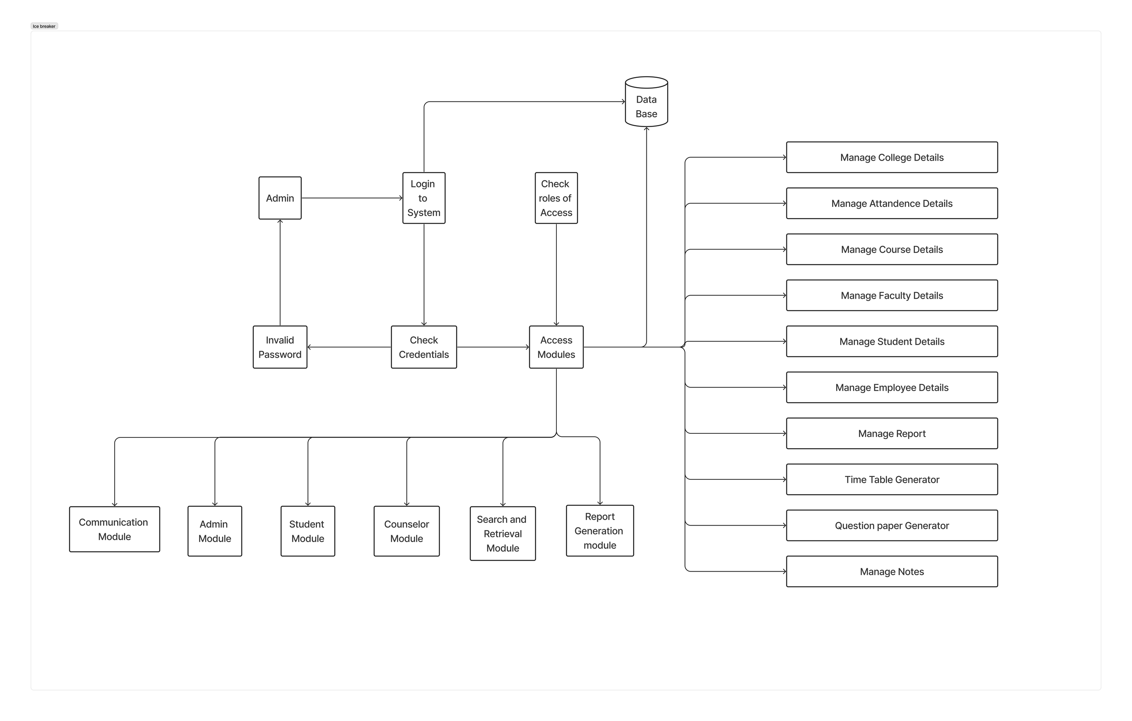
SYSTEM ARCHITECTURE

Slide 17
User Access and Authentication:
a. Users navigate to the CIMS web application through their preferred web browser.
b. Upon reaching the login page, users input their credentials, including username and password.
c. The system verifies the user's credentials for authentication.
Role Determination:
a. After successful authentication, the system determines the role of the authenticated user based on their user profile.
b. Roles may include faculty, student, counselor, or administrator.
Role-Specific Interfaces:
a. Based on the authenticated role, users are directed to personalized dashboards or interfaces tailored to their specific roles.
b. Faculty members access features such as educational resource management, communication tools, and attendance marking.
SYSTEM ARCHITECTURE

Slide 18
c. Students explore resources, communicate with faculty, view marks, and attendance.
d. Administrators navigate a comprehensive dashboard with employee and student management, system configuration, and reporting tools.
Educational Resource Management:
a. Faculty members upload educational notes, question papers, and other resources to the system.
b. Students access these resources through their dashboard, enhancing their learning experience.
Communication:
a. Faculty and students engage in communication through the messaging system within the system.
b. Sent and received messages are stored for reference, fostering effective collaboration.
Attendance and Marks Management:
a. Faculty members mark attendance and upload student marks through dedicated modules in the system.
b. Students can view their marks and attendance records through their dashboard interfaces.
SYSTEM ARCHITECTURE

Slide 19
System Configuration by Administrators:
a. Administrators manage employees and students, add or delete records, and configure system-wide settings.
Reports Generation:
a. Administrators generate reports on various aspects of college information, such as marks distribution and academic performance.
b. Reports can be customized based on specific criteria and parameters.
Search and Retrieval:
a. All users can efficiently search for specific information within the system using the search and retrieval module.
b. The module ensures swift and precise data access across multiple modules of the CIMS.
Logout:
a. Users securely log out from the system, concluding their session.
b. The system handles session management to prevent unauthorized access after logout.
SYSTEM ARCHITECTURE

Slide 20
Our proposed College Management System (CMS) is a comprehensive platform designed to streamline and enhance various aspects of educational administration. The system comprises distinct modules catering to user authentication, student interaction, counseling services, administrative oversight, search and retrieval, reports generation, and communication.
User Authentication Module:
Student Module:
Counselor Module:
Administrator Module:
Search and Retrieval Module:
Reports Generation Module
Communication Module:
MODULES

Slide 21
1. User Authentication Module:
The system ensures a secure and efficient login process, employing robust authentication mechanisms. It recognizes different user types, distinguishing between students and employees. Passwords are encrypted to safeguard user credentials, and a recovery mechanism is in place for user convenience.
2. Student Module:
The Student Module provides students with a user-friendly interface for accessing academic resources. From viewing course notes and previous question papers to checking exam marks and faculty details, students can seamlessly navigate their educational journey. The module also facilitates effective communication through messaging and offers a comprehensive overview of attendance records.
MODULES

Slide 22
3. Faculty Module:
Tailored for academic counselors, this module enables personalized guidance and effective monitoring of student progress. Counselors can communicate by addressing academic doubts, career, and personal concerns.
4. Administrator Module:
The Administrator Module empowers system administrators with centralized control. From managing employees and students to uploading marks, generating timetables, and configuring system settings, administrators play a pivotal role in maintaining the system's integrity and adapting it to institutional needs. To do complicated optimization tasks like creating timetables, managing staff and students, configuring system settings, assigning grades, and creating personalized reports, we have also deployed genetic algorithms.
MODULES

Slide 23
5. Search and Retrieval Module:
Efficiency in data retrieval is a key focus of the Search and Retrieval Module. Users can quickly find specific information, be it related to courses, faculty details, or student records. An intuitive search algorithm enhances the user experience, allowing for swift and precise data access.
6. Reports Generation Module:
Administrators can derive valuable insights from the Reports Generation Module. Customizable report parameters provide flexibility in generating attendance reports, marks distribution, and system usage. This module supports data-driven decision-making and aids in assessing the overall performance of the educational platform.
MODULES

Slide 24
7. Communication:
Faculty and students engage in communication through the messaging system.
Sent and received messages are stored for reference, fostering effective collaboration.
MODULES

Slide 25
The College Management System (CMS) relies on the SQLite database to efficiently manage and store the vast array of information essential for the project's functionalities. The database schema is user-defined, aligning closely with the specific requirements of the CMS.
In the Firebase database, we created tables to store information related to employee and student details-
exam marks
attendance records
notes
messages, and other pertinent data.
DATABASE

Slide 26

UML DIAGRAMS
Unified Modeling Language (UML) diagrams are a standard way to visually represent the design of a system. UML diagrams can be used to model the static structure of a system, the dynamic behavior of a system, and the interactions between different parts of a system.
It is a prominent visual modeling language used to create, visualize, specify, and record the behavior and structure of software systems and other systems.
Software engineers, system architects, and designers can develop visual models of systems with the help of a set of graphical notations provided by UML.
The main method for illustrating various system components is using UML diagrams. The visual model provided by UML enables stakeholders to clearly and concisely discuss, assess, and comprehend different system components.

Slide 27
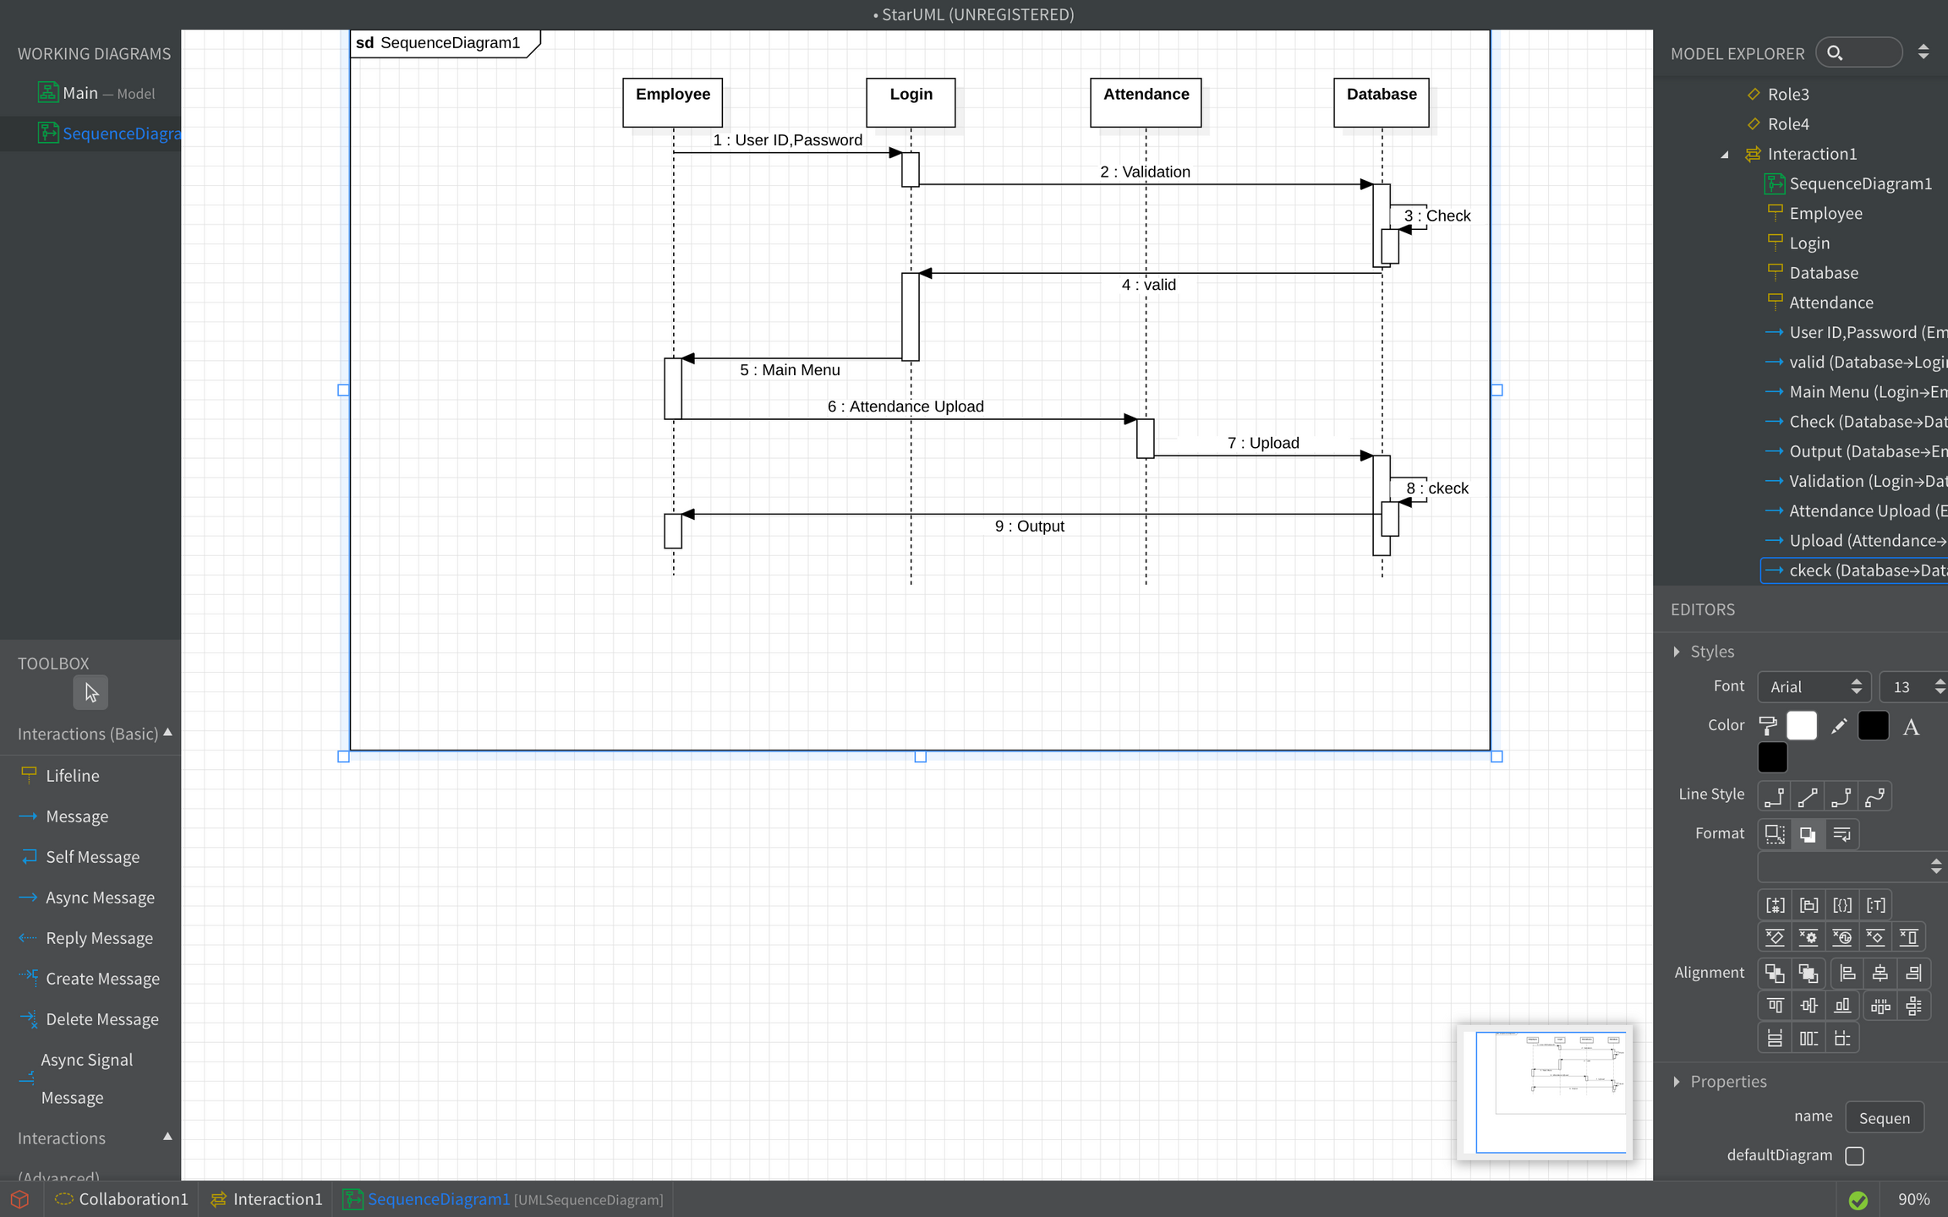
SEQUENCE DIAGRAM-1
A sequence diagram is a type of UML (Unified Modeling Language) diagram used in software engineering. The description of the interaction based on the sequence diagram
The Employee enters a User ID and Password (1).
The Login component validates the User ID and Password (2).
The system checks the validation (3).
If the validation is successful (4), the system displays the Main Menu (5).
The Employee selects Attendance Upload (6).
The Attendance component uploads the attendance data (7).
The system checks the upload (8).
The system outputs a message (9), which could be a success or error message.

Slide 28
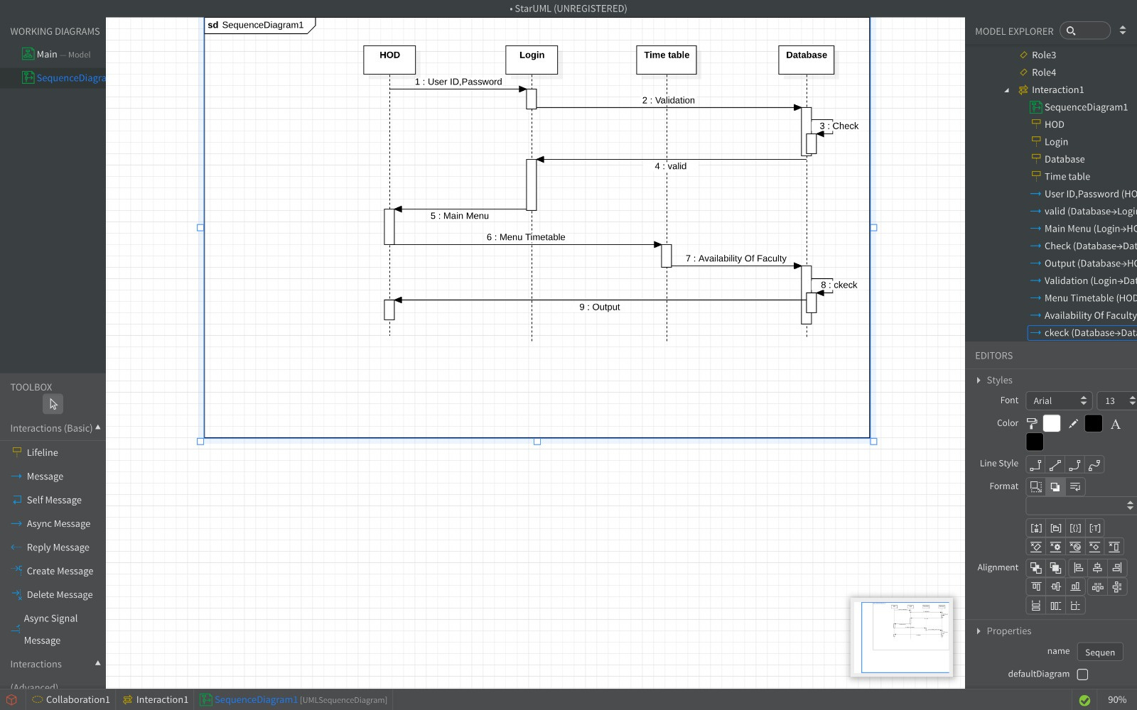
SEQUENCE DIAGRAM-2
1. The system starts with a login sequence diagram.
2. The user enters their ID and password.
3. The system validates the login credentials.
4. If the credentials are valid, the system proceeds to the Main Menu.
5. From the Main Menu, the user can select the Timetable Menu.
6. The Timetable Menu shows the user a “Check Availability of Faculty” option.
7. When the user selects this option, the system checks the database for faculty availability.
8. The system then validates this information.
9. The system outputs the results to the user.

Slide 29
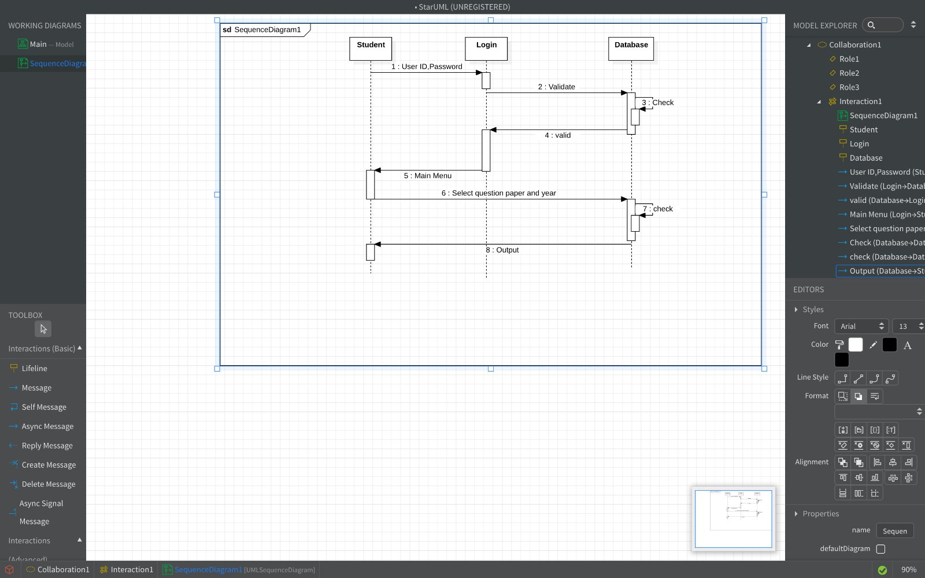
SEQUENCE DIAGRAM-3

Slide 30
SEQUENCE DIAGRAM -3
1. The system starts with the start entity, which initiates the interaction.
2. The start entity sends a message to the Login entity.
3. The Login entity then sends a message to the User ID and Password entities. Presumably, this would prompt the student to enter their login credentials.
4. Once the User ID and Password entities receive the login credentials, they most likely send a message back to the Login entity.
5. The Login entity then sends a message to the Validation entity, which would verify the login credentials against a database.
6. If the credentials are valid, the Validation entity would send a message back to the Login entity.
7. The Login entity would then send a message to the Main Menu entity.
8. The Main Menu entity would then likely provide the student with a menu of options such as “Past Papers”.
9. If the student selects “Past Papers”, the Main Menu entity would send a message to the Select Question Paper entity.
10. The Select Question Paper entity would most likely then allow the student to select the paper they are interested in based on course or subject.
11. Once the student selects the paper, the Select Question Paper entity would send a message to the Database entity to retrieve the paper.
12. The Database entity would then send the question paper back to the Select Question Paper entity.
13. The Select Question Paper entity would then send the question paper to the Output entity, which would display the paper to the student.

Slide 31
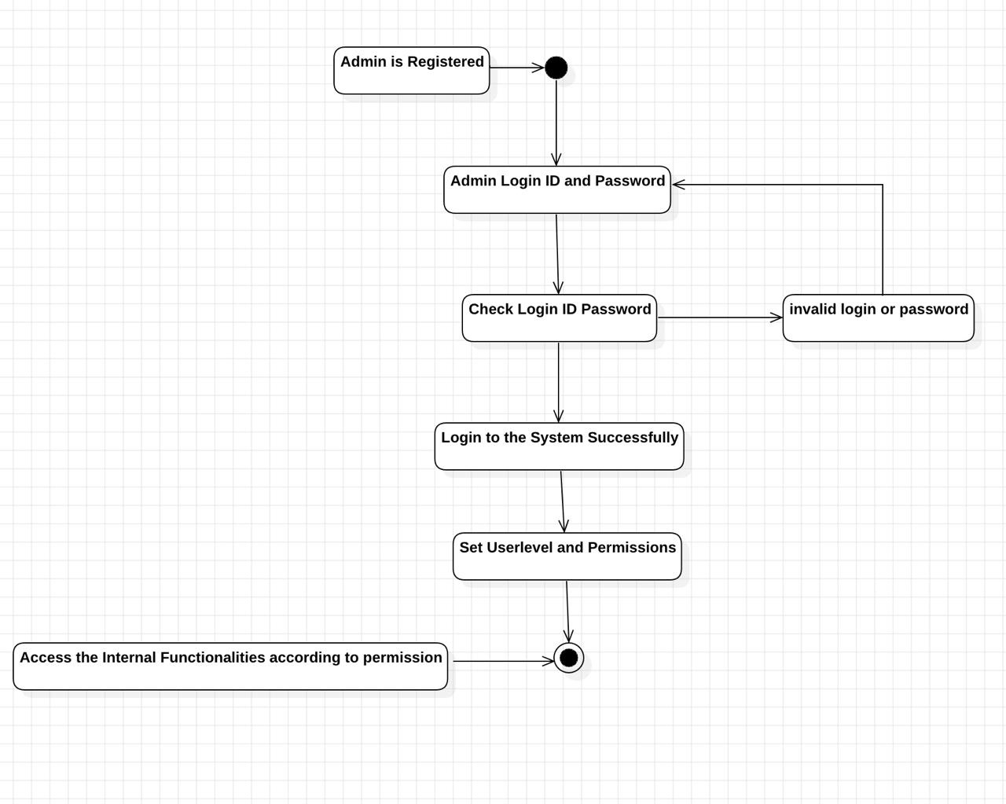
ACTIVITY DIAGRAM-1
Activities:
Login : This activity represents the core function of the diagram, indicated by the thicker line.
The user enters their login ID and password.
The system validates the login credentials (not shown in detail).
Decision Point:
After validating the credentials, the system checks if they are valid.
If the credentials are valid (Yes branch), the system logs the user in successfully (shown as a single horizontal line).
If the credentials are invalid (No branch), an error message is displayed (shown as a rectangle with rounded corners), likely prompting the user to re-enter their credentials.

Slide 32
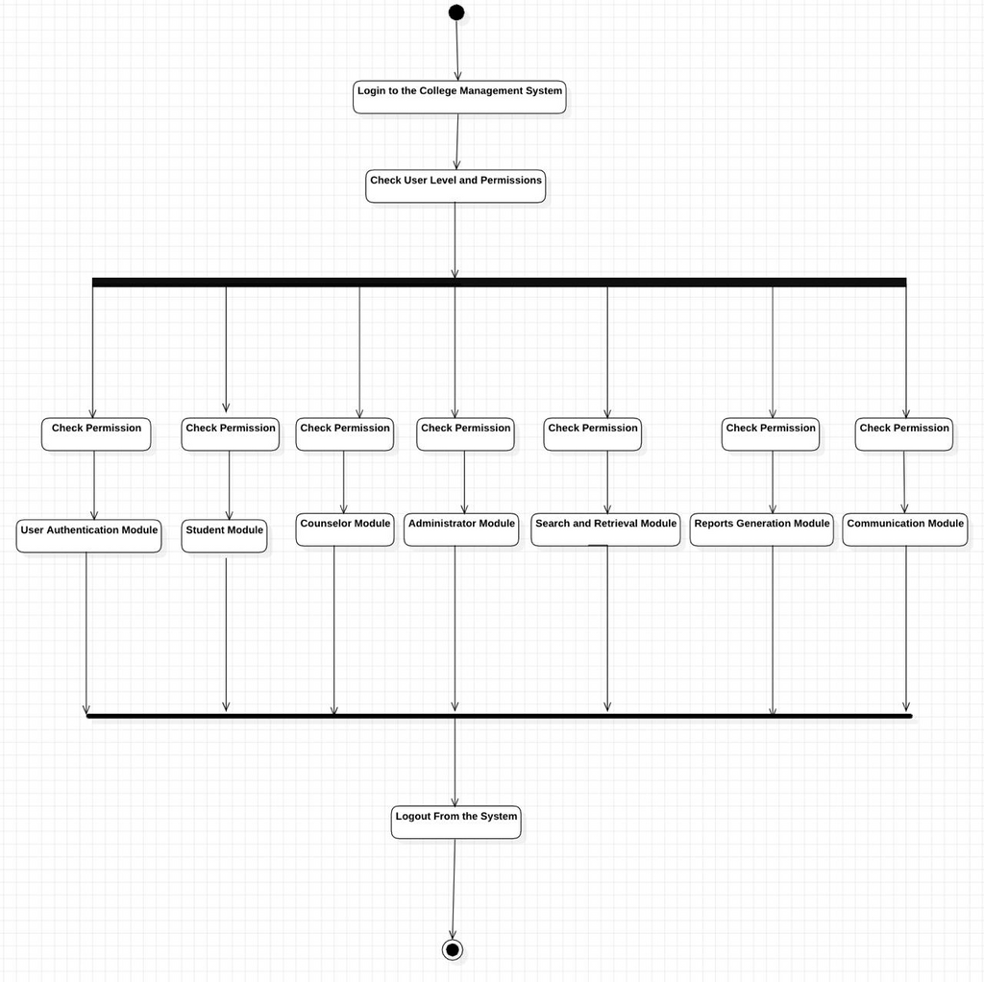
ACTIVITY DIAGRAM-2

Slide 33
ACTIVITY DIAGRAM -2
1. The process starts with a user logging into the system. This could be a student, faculty member, or administrator, depending on the system's user base.
2. Once a user logs in, the system checks their user level and permissions. Based on the user's level and permissions, the system grants access to specific modules or functionalities
3. Depending on the user's role (student, faculty, or administrator), they will have access to specific functionalities within the system. The diagram shows six possible modules:
Student Module
Counselor Module (This might be a typo and could represent the 'Counselor' role)
Administrator Module
Search and Retrieval Module
Reports Generation Module
Communication Module
4. The activity diagram shows a logout option available from any system module. This allows users to end their session securely.

Slide 34
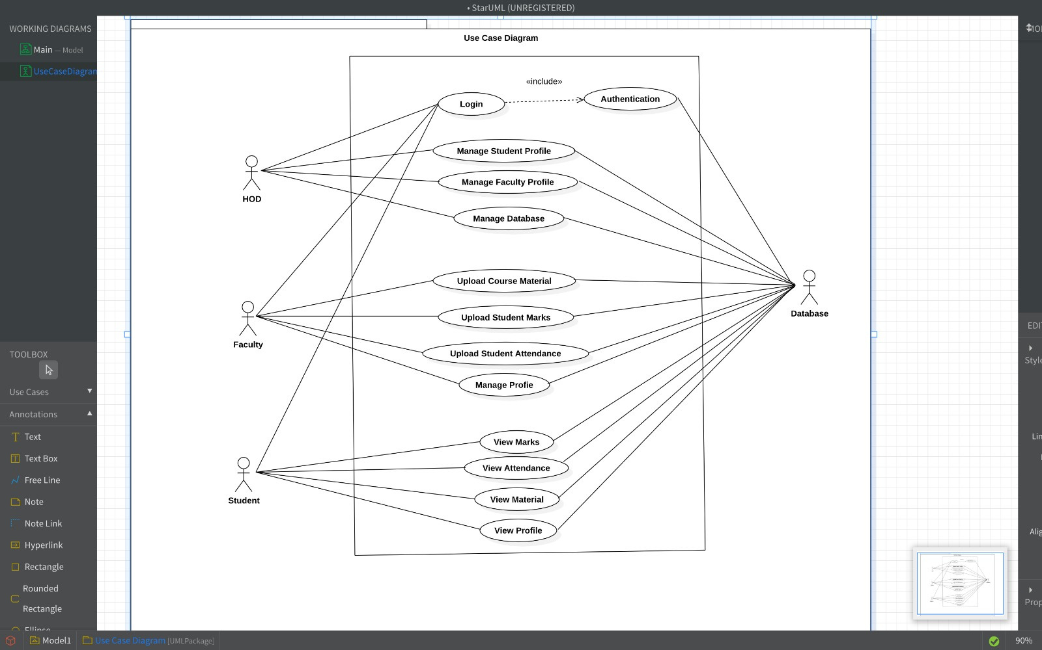
USE CASE DIAGRAM

Slide 35
USE CASE DIAGRAM
Actors:
Faculty: Instructors or professors who utilize the system to manage their courses and student information.
Student: Learners who access the system to view course materials, check grades, and manage their profiles.
Admin: System administrators responsible for managing user accounts, access control, system configurations, and potentially data backups.
Use Cases:
Login: All actors (faculty, student, and admin) need to log in using unique credentials.
Manage Student Profile: Students can update their personal information within the system.
Manage Faculty Profile: Faculty can update their profile details and potentially manage settings related to their courses.
Manage Database: This use case likely involves the admin adding, removing, or modifying student and faculty data within the system.
Upload Course Material: Faculty can upload resources such as lecture notes, presentations, or assignments for students to access.
Upload Student Marks: Faculty can upload student grades or marks into the system for students to view.
Upload Student Attendance: Faculty can record student attendance within the system.
View Marks: Students can access their marks uploaded by faculty.
View Attendance: Students can view their attendance records.
View Material: Students can access course materials uploaded by faculty.
View Profile: Both students and faculty can view their own profile information within the system.

Slide 36
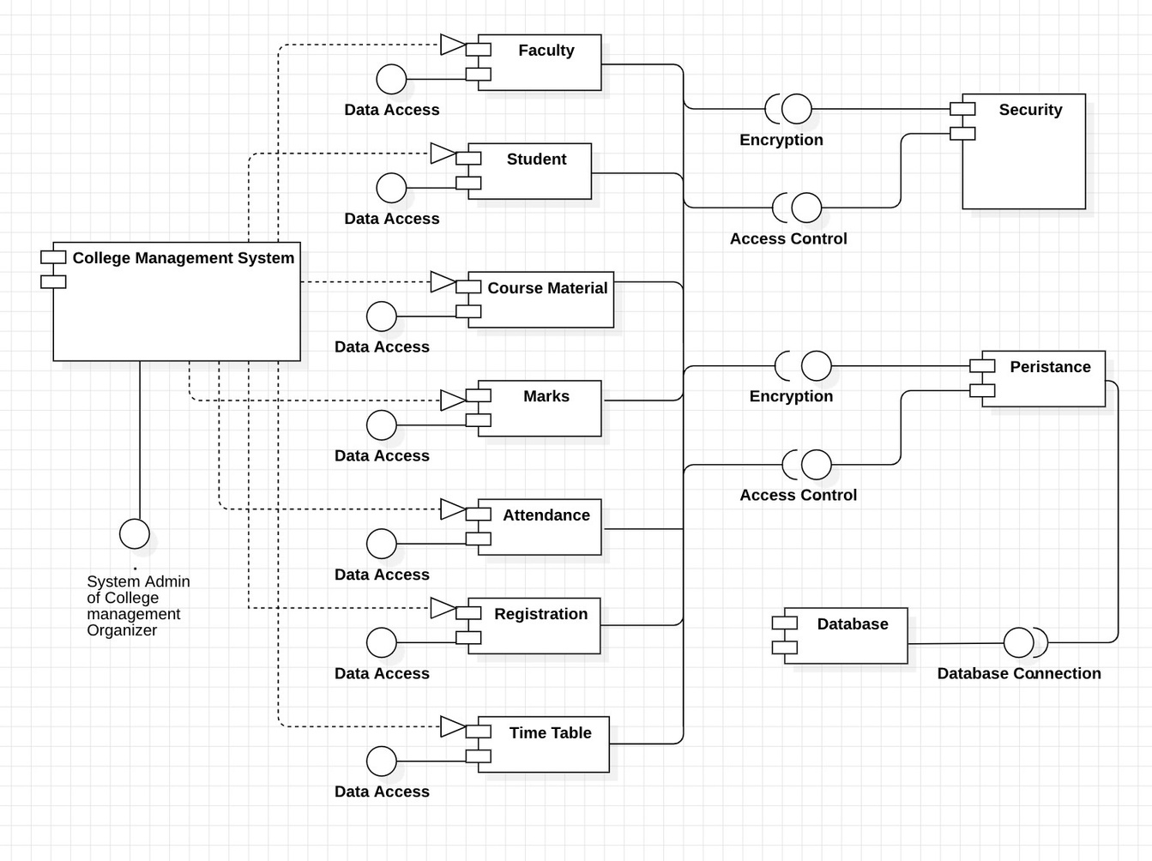
COMPONENT DIAGRAM

Slide 37
COMPONENT DIAGRAM
COMPONENTS:
Database: Stores all college data, including student information, faculty information, course information, grades, attendance records, and potentially course materials
Security: Protects the system from unauthorized access and data breaches. Employs encryption techniques and secure login procedures to safeguard sensitive data.
System Admin: Represents the system administrator responsible for managing the overall system. Handles tasks like adding/removing users, managing user permissions, and configuring system settings.
Time Table: Displays the course schedule or timetable for students and faculty. Provides an overview of course timings and schedules.
Student: Enables students to view their profiles, register for courses, access course materials, view grades and attendance records, and potentially perform other student-related tasks.
Faculty: Allows faculty to view their profiles, manage courses, upload course materials, view student rosters, upload student grades and attendance, and potentially manage other course-related tasks.
Course Material: Stores course materials uploaded by faculty, such as lecture notes, presentations, or assignments. Provides a centralized location for students to access learning resources.
Marks: Stores student grades or marks uploaded by faculty. Enables students to view their academic performance within the system.
Attendance: Stores student attendance data uploaded by faculty. Allows students to view their attendance records and track their presence in classes.
Encryption: Encrypts sensitive data before storing it in the database or transmitting it across the network. Protects sensitive information like student details and grades from unauthorized access.

Slide 38
COMPONENT DIAGRAM
DEPENDENCIES:
All components rely on the Database to store and retrieve data.
Data Access acts as a bridge, facilitating communication between other components and the database.
Access Control depends on user authentication mechanisms to function effectively.
Security components rely on various tools and protocols to safeguard the system.
System Admin functionalities depend on access to user data and system configurations.
Registration relies on data access to the student database and potentially course information.
Time Table depends on data access to course schedules and potentially faculty and student information.
Student and Faculty components depend on access control mechanisms to ensure appropriate user permissions.
Course Material relies on data access to store and retrieve uploaded materials.
Marks and Attendance components depend on data access to store and retrieve student grades and attendance records, respectively.
Encryption is often integrated with data storage and transmission processes.

Slide 39
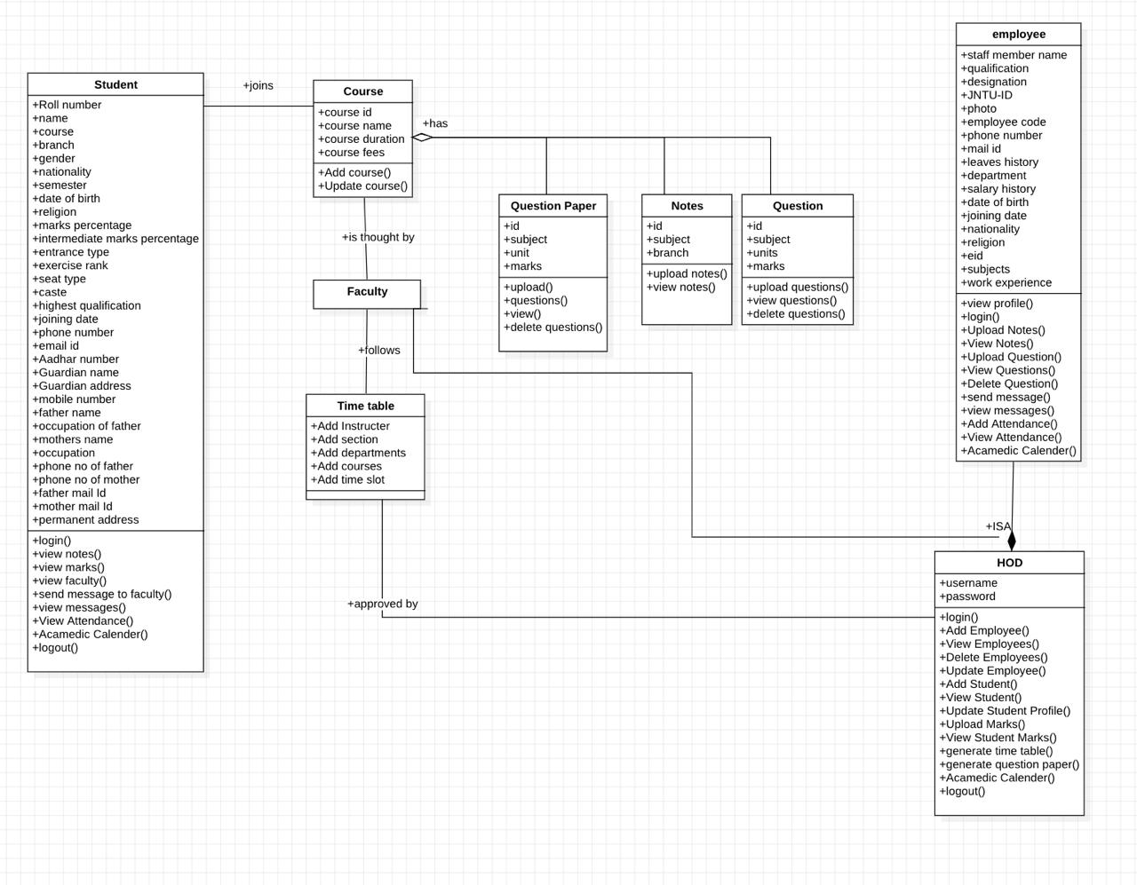
CLASS DIAGRAM

Slide 40
MODULES DESCRIPTION
Our proposed CMS is a comprehensive platform designed to streamline and enhance various aspects of educational administration. It offers a range of modules tailored to meet the specific needs of educational institutions, ensuring efficiency, transparency, and collaboration across all levels. The modules we used in the system are:
Timetable Generator: Automates scheduling of classes, exams, and events. Allows for instructor assignment, section and department allocation, course mapping, and flexible time slot management.
Question Paper Generator: Simplifies the creation of customized question papers. Supports different question types and units, with customizable options for difficulty level, topic coverage, and randomization. Total questions generated include 2 marks (5), 3 marks (5), and 5 marks (20).
Communication Module: Facilitates seamless communication between the institution and parents. Enables the sending of messages regarding student performance, attendance, and marks through customizable email templates.

Slide 41
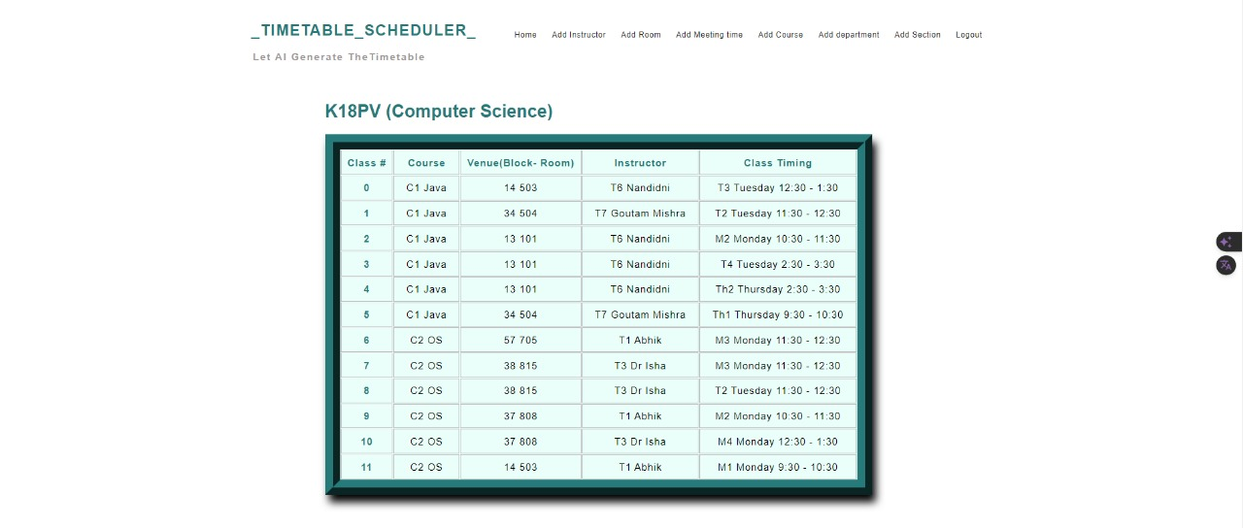
MODULES DESCRIPTION
TIMEBTABLE GENERATOR:
Efficiently schedules classes, exams, and other events based on predefined criteria and user preferences.
Automatically generates timetables, taking into account various factors such as faculty availability, classroom availability, and student preferences.
Enables easy modification and adjustment of schedules, ensuring flexibility and adaptability to changing circumstances.
Facilitates seamless coordination among faculty, students, and administrators by providing real-time access to updated schedules.

Slide 42
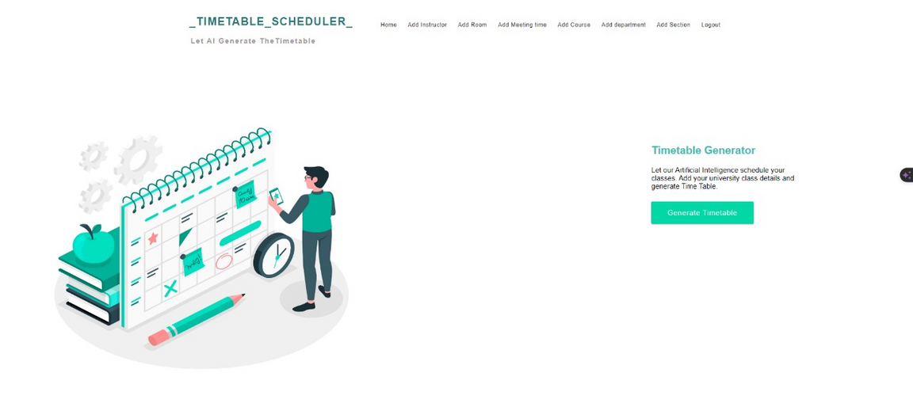
MODULES DESCRIPTION
The features of this module are :
Add Instructor: This feature allows administrators or faculty members to assign instructors to specific classes or time slots, ensuring that each class has an instructor assigned.
Sections and Departments: Users can allocate sections (e.g., A, B, C) and departments (e.g., Science, Arts) to respective classes or courses, facilitating organization and management within the system.
Courses: Administrators can map courses to their corresponding sections, ensuring that the timetable reflects the schedule for each course offered by the institution.
Time Slots: The module provides the flexibility to define and manage time slots for classes, exams, and other events, allowing users to set the duration and timing of each session.

Slide 43
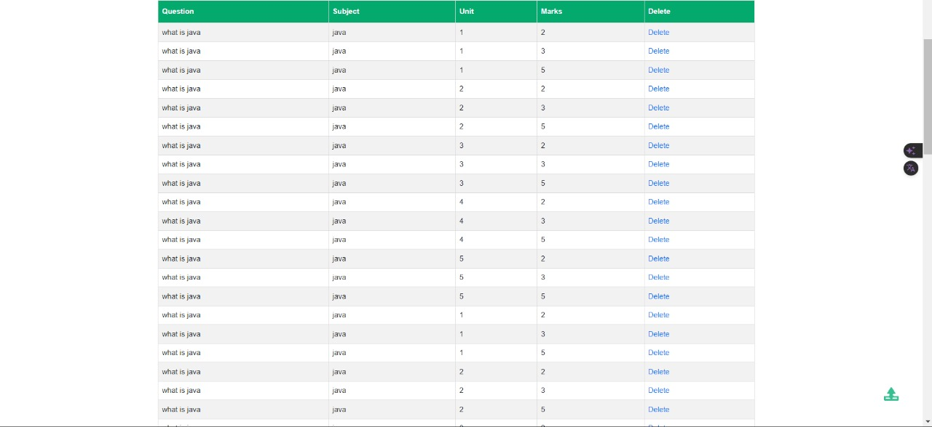
MODULES DESCRIPTION
QUESTION PAPER GENERATOR:
Simplifies the process of creating customized question papers for exams and assessments.
Offers a diverse range of question formats, including short answer, essay, and more.
Incorporates question bank management functionalities, allowing easy organization, retrieval, and reuse of questions.
Ensures fairness and accuracy in assessments through randomization and customization options.
2marks -5
3 marks-5
5 marks - 20

Slide 44
MODULES DESCRIPTION
COMMUNICATION MODULE:
Parent Communication: Enable administrators and faculty members to send personalized messages to parents regarding student performance, attendance, and other relevant information.
Automated Reporting: Automate the generation and distribution of reports to parents at regular intervals, providing timely updates on student progress and performance.
Privacy and Security: Ensure that communication channels adhere to strict privacy and security protocols, safeguarding sensitive student information and maintaining confidentiality.
Feedback Mechanisms: Facilitate two-way communication by providing mechanisms for parents to respond to messages or provide feedback, fostering greater engagement and collaboration.

Slide 45
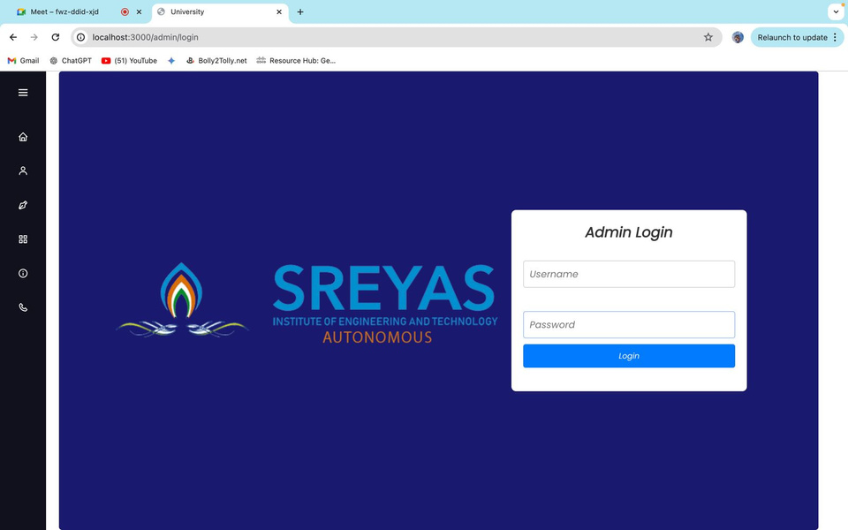
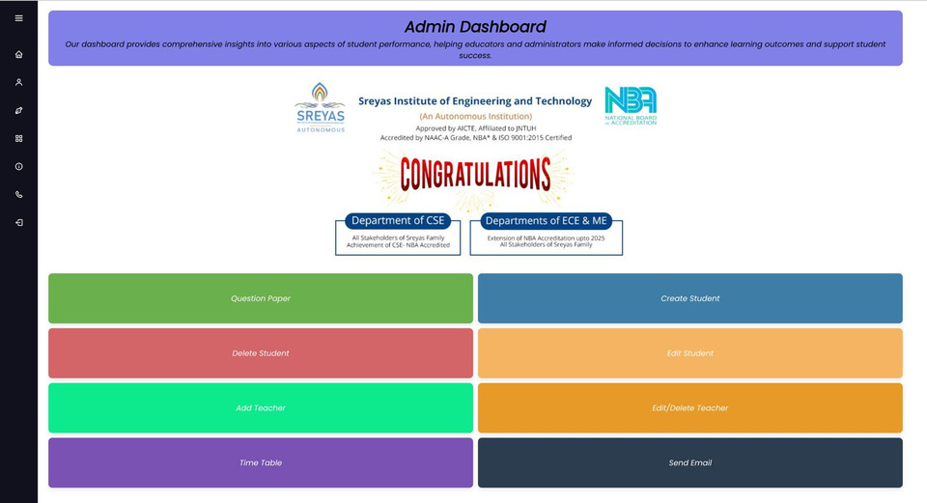
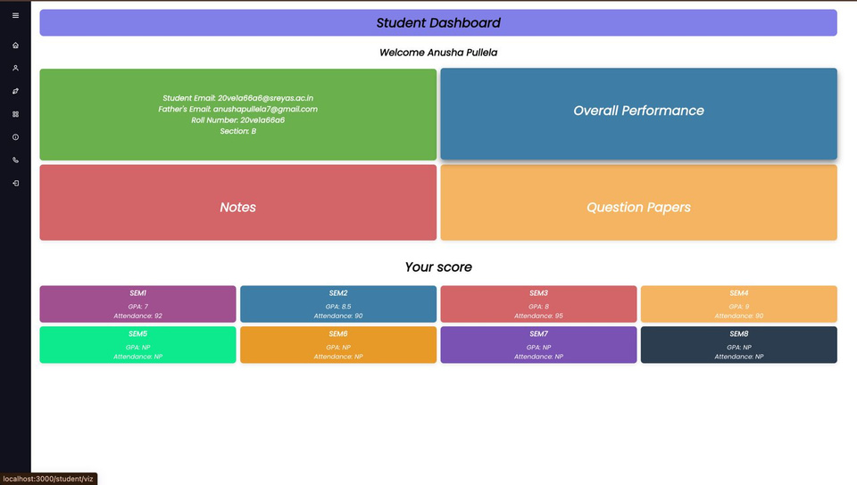
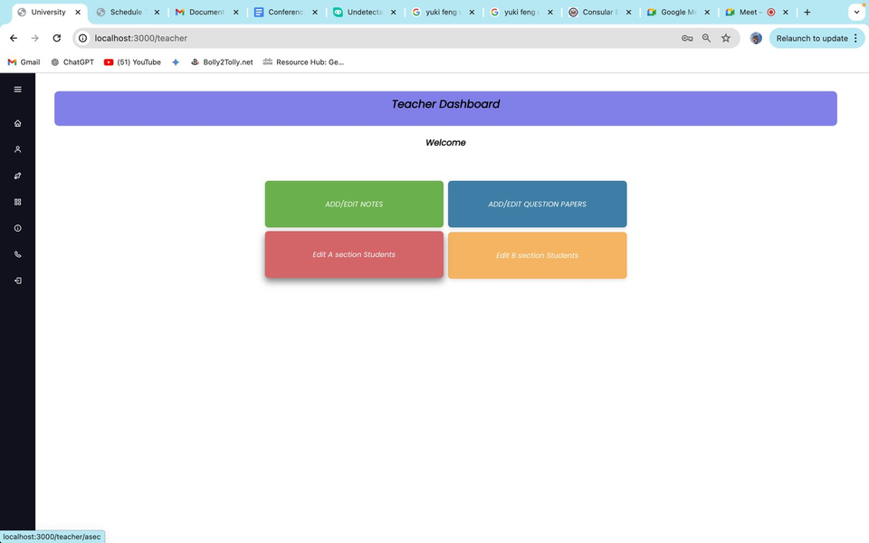
RESULTS

Slide 46
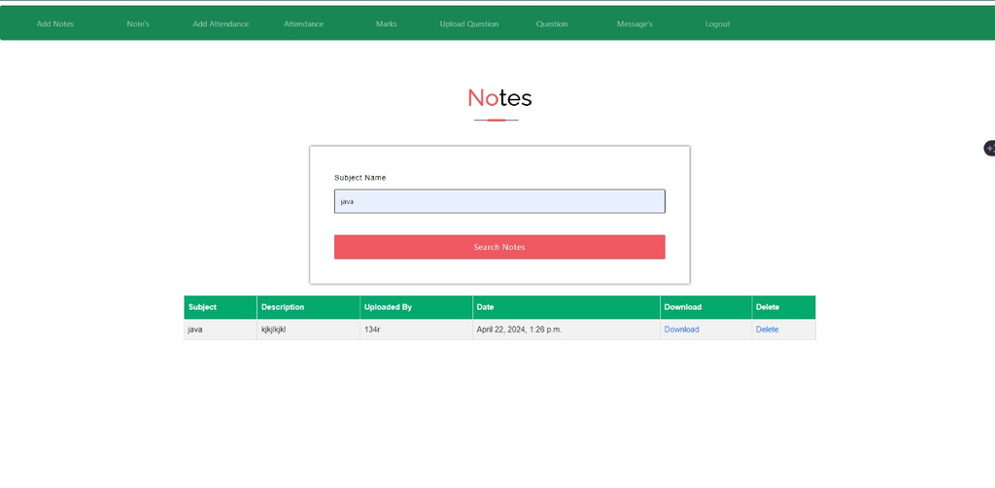
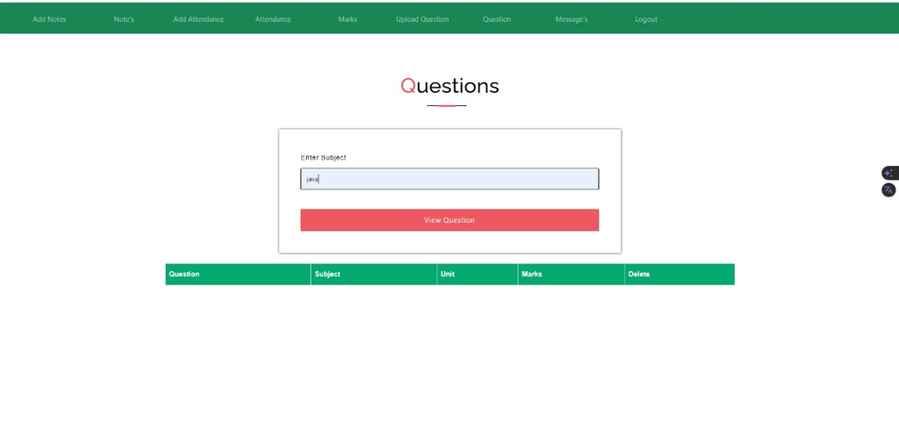

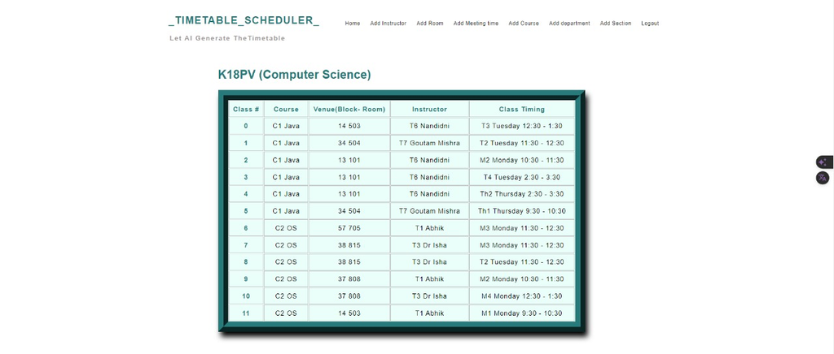
RESULTS

Slide 47
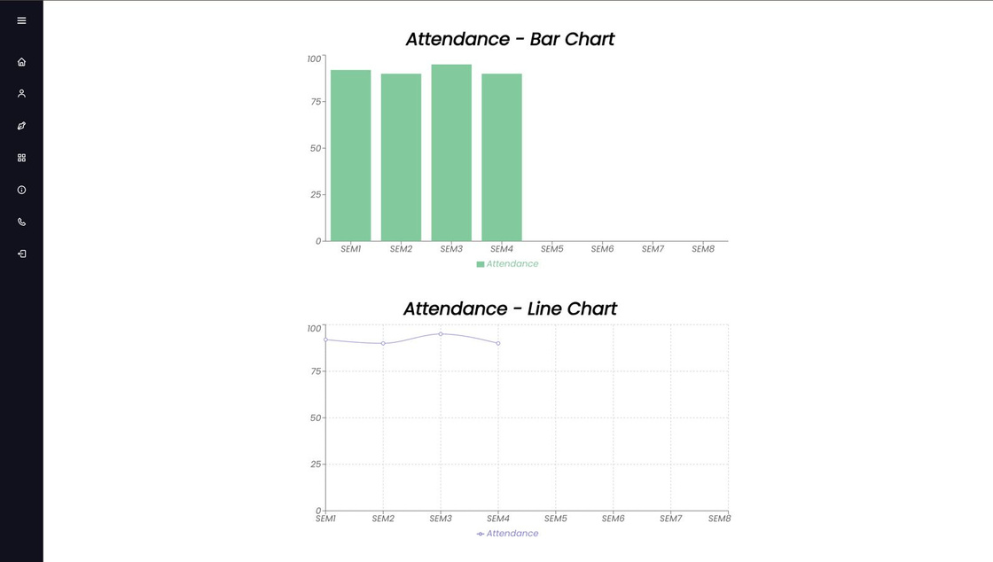
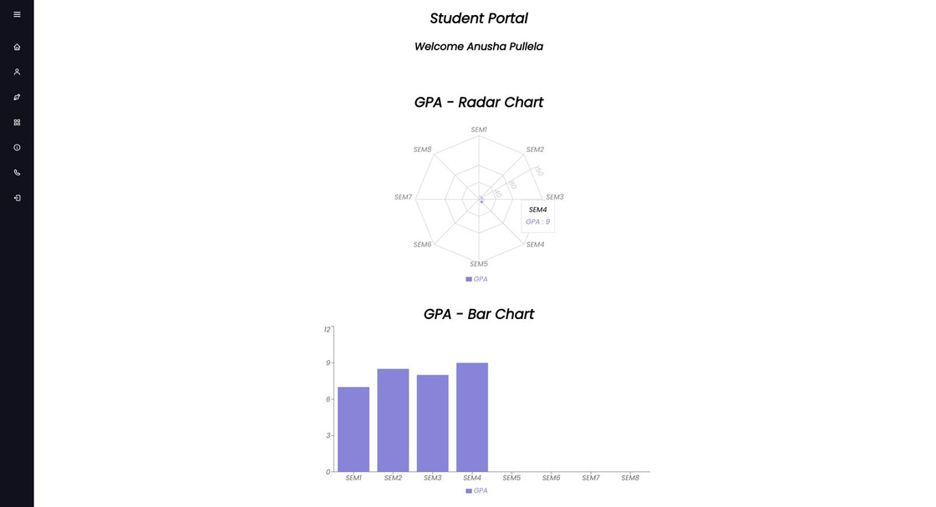
RESULTS

Slide 48
In conclusion, the College Information Management System (CIMS) stands as a transformative solution for educational institutions, offering streamlined administrative processes, enhanced resource management, and improved communication channels. By integrating modules such as user authentication, college management, and communication, CIMS empowers students to efficiently manage records, attendance, and academic resources. Its integration of past question papers facilitates exam preparation, while its intuitive interface fosters enhanced interaction between faculty and administrators. With CIMS, educational institutions can navigate the complexities of administrative tasks with ease, fostering a conducive environment for learning and growth. Through its comprehensive functionalities and user-friendly design, CIMS represents a pivotal step towards optimizing operations and promoting excellence within educational institutions.
CONLCUSION

Slide 49
1. Kumar, A., & Singh, R. (2022). Development and Implementation of an Intelligent Student Management System Using Machine Learning Techniques. Journal of Information and Communication Technology Research, 16(3), 215-223.
2. El-Khouri, F., & Al-Haddad, H. (2021). A Mobile-Based Student Management System for Enhanced Student Engagement and Performance. Journal of Emerging Technologies in Learning, 16(2), 45-58.
3. Dwivedi, A., & Gupta, V. K. (2020). A Review of Student Management Systems: Challenges and Future Directions. International Journal of Computer Applications, 1(8), 73-78.
4. Sharma, N., & Sharma, D. (2019). Design and Development of a Web-Based Student Management System Using ASP.NET and SQL Server. Journal of Engineering Science and Technology, 14(4), 1698-1702.
5. El-Sherif, H., & El-Sakka, A. A. (2018). A Robust Cloud-Based Student Management System Using Blockchain Technology. IEEE Access, 7(1), 11950-11956.
REFERENCES

Slide 50
6. Singh, S., & Kumar, D. (2017). A Scalable and Secure Student Management System Using Cloud Computing: A Case Study. International Journal of Engineering Science and Technology, 9(10), 3778-3783.
7. Alhudhaif, A., & Alghamdi, A. (2016). Designing and Implementing a Mobile-Based Student Management System Using AngularJS and Node.js. International Journal of Engineering and Technology, 7(7), 2213-2223.
8. Khan, M. F., & Mahmood, T. (2015). A Secure Student Management System Using Cloud Computing and Cryptography Techniques. International Journal of Advanced Research in Computer Science and Software Engineering, 5(10), 202-207.
9. Gupta, R., & Singh, S. (2014). Design and Development of a Student Management System for Online Education. International Journal of Engineering Science and Technology, 6(1), 236-243.
10. Jain, V., & Singh, S. (2013). A Comprehensive Review of Student Management Systems: Features, Challenges, and Future Directions. International Journal of Computer Applications, 82(7), 28-33.
REFERENCES

Slide 51
QUERIES ?

